Slide 1

Hello World! Machine Learning Concepts
definitions Model pipeline feature types scikit-learn conclusions

Slide 2

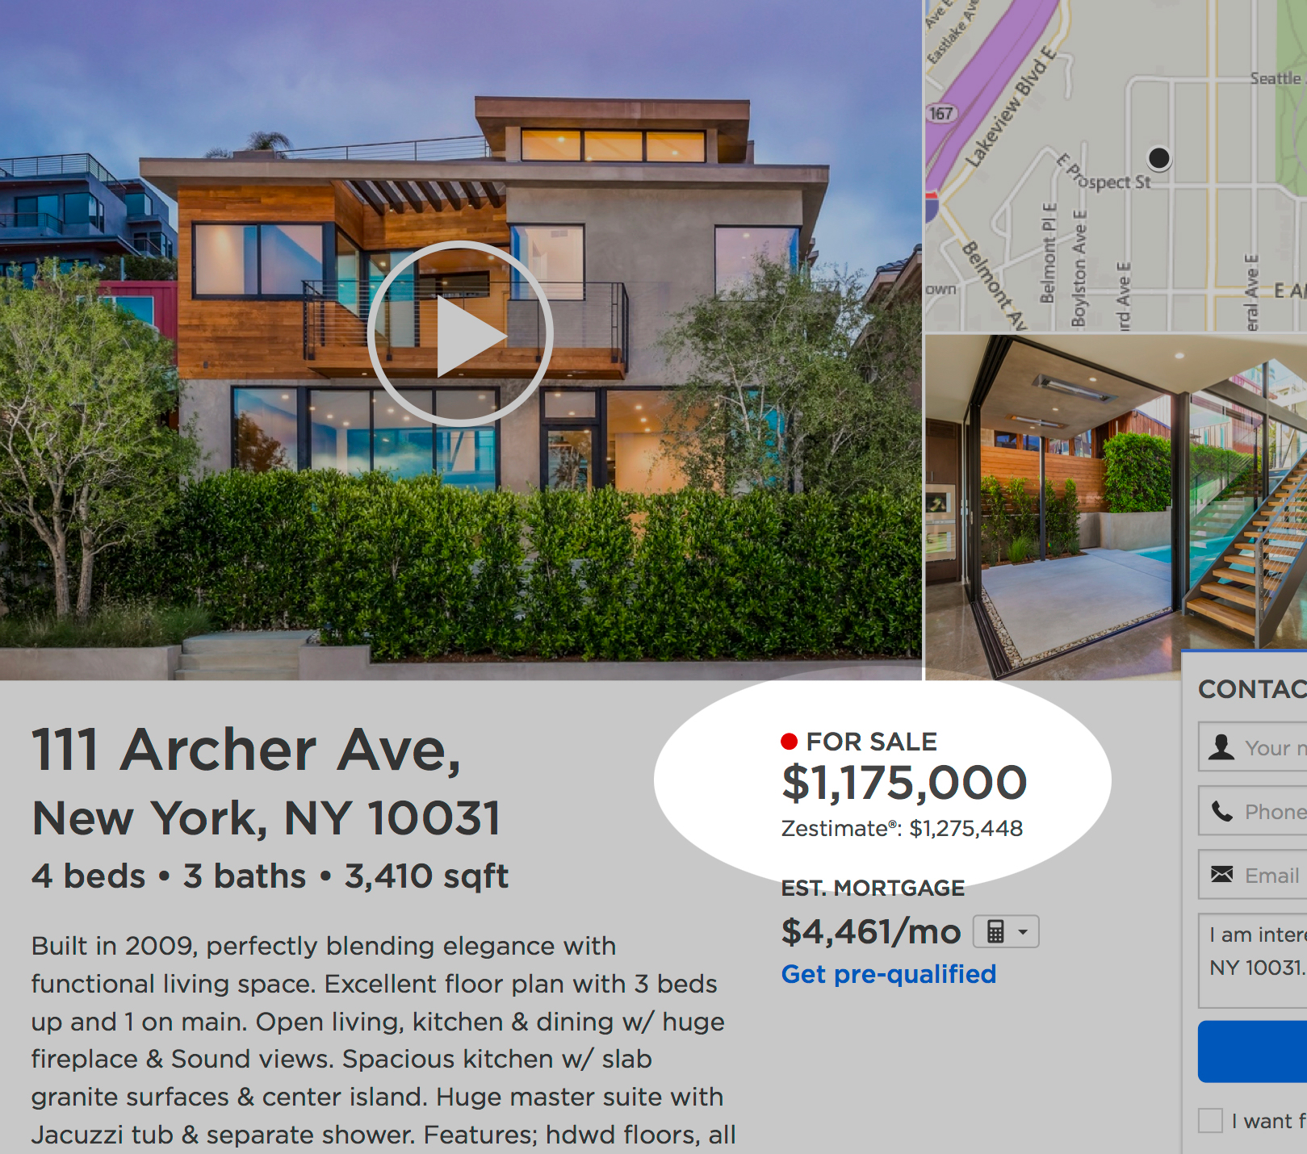
House price prediction
Want to learn to predict house price…
…Analyze information about & prices of 100501 houses
https://www.kaggle.com/c/zillow-prize-1/overview/competition-overview

Slide 3
House price prediction
Want to learn to predict house price…
https://www.kaggle.com/c/zillow-prize-1/overview/competition-overview

Slide 4
Definitions
𝒙 — example / object / observation house (information about it)
𝕏 — object space (all considered houses)
𝒚 — target / response house price
𝕐 —answers space positive real numbers
https://www.kaggle.com/c/zillow-prize-1/overview/competition-overview

Slide 5
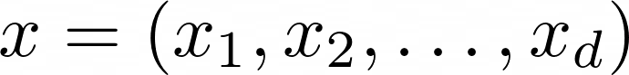
Definitions: features
𝒙 — example / object / observation
Every example (house) is described by the set of characteristics (for ex., numbers) – features.

Slide 6
Definitions: features
𝒙 — example / object / observation
Every example (house) is described by the set of characteristics (for ex., numbers) – features.
We will have different features describing houses:
Room count
State/region
Space
….

Slide 7
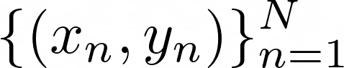
dataset
Definition:
The set of objects and answers to them
N — size of the dataset (object count)
https://www.kaggle.com/c/zillow-prize-1/overview/competition-overview

Slide 8
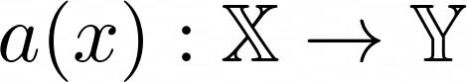
model
Definition:
Model is a function that predicts answers for the object 𝒙:

Slide 9
model
Definition:
Model is a function that predicts answers for the object 𝒙 :
Example: linear model

Slide 10
Parameters and hyperparameters
Definitions:
Model is a function that predicts answers for the object 𝒙 :
Parameters – something that we learn about a(x) from data
(coefficients of our model)

Slide 11
Parameters and hyperparameters
Definitions:
Model is a function that predicts answers for the object 𝒙 :
Example: linear model
Where are parameters here?

Slide 12
Parameters and hyperparameters
Definitions:
Model is a function that predicts answers for the object 𝒙 :
Parameters – something that we learn about a(x) from data
(coefficients of our model)
Hyperparameters – configuration of the model, that is defined manually when we choose the model

Slide 13
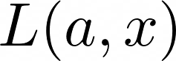
Loss function
Definitions:
Loss (function) – function that measures how predictions differ from the answer

Slide 14
Loss function
Definitions:
Loss (function) – function that measures how predictions differ from the answer
Predicting house price
What function can we take?
https://www.kaggle.com/c/zillow-prize-1/overview/competition-overview

Slide 15
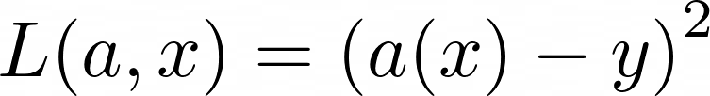
Loss function
Definitions:
Loss (function) – function that measures how predictions differ from the answer
Predicting house price
The square of difference:
https://www.kaggle.com/c/zillow-prize-1/overview/competition-overview

Slide 16

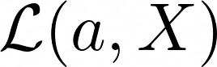
Loss function
Definitions :
Loss (function) – function that measures how predictions differ from the answer

Slide 17
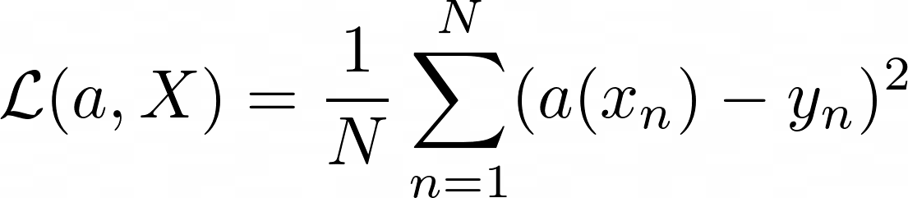
Loss function
Definitions :
Loss (function) – function that measures how predictions differ from the answer
The square of difference mean square error
https://www.kaggle.com/c/zillow-prize-1/overview/competition-overview

Slide 18
Training of the model
Definitions:
We have a dataset and loss function

Slide 19
Training of the model
Definitions:
We have a dataset and loss function
We choose the family of models 𝒜
The type of which model we will consider
For example, linear regression

Slide 20
Model training
Definitions:
We have a dataset and loss function
We choose the family of models 𝒜
The type of which model we will consider
For example, linear regression
Training – the choice of optimal model in terms of the loss function
Less formal: training – the search of the best parameters among all possible

Slide 21
ML Pipeline

Slide 22
Pipeline
ML
Model
Training
Loss
Training Dataset
Trained model

Slide 23
Pipeline
ML
Model
Training
Loss
Training Dataset
Trained model
Metric
Test Dataset
Testing
Model Quality

Slide 24
Pipeline
ML
Models
Training
Loss
Training Dataset
Trained models
How to select the best model?
Metric
Test Dataset
Testing
Model Quality

Slide 25
Pipeline
ML
Models
Training
Loss
Training Dataset
Trained models
Validation Dataset
How to select the best model?
Metric
Test Dataset
Testing
Model Quality

Slide 26
Pipeline
ML
Models
Training
Loss
Training Dataset
Trained models
Validation Dataset
Compare the models
Metric
Best model
Test Dataset
Testing
Model Quality

Slide 27
Feature types

Slide 28


Examples:
- Size of the house
- Client salary - Patient blood pressure
Numerical
— possible value of j-th feature

Slide 29
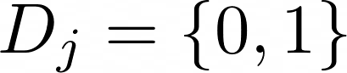
Binary
Variables - flags
Examples:
- Is there a garage in the house
- Whether a client has kids - Whether a client has citrus allergy
— possible values of j-th feature

Slide 30
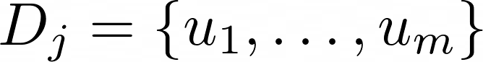
Categorical
Feature values can’t be ranked!
Examples:
- State where the house was built
- Client citizenship - The primary physician of the patient
— possible values of j-th feature

Slide 31
One-hot-encoding instead of feature with m values create m binary features
Frequency Encoding
How often category occurs in data
Mean Target Encoding
Mean value of the target variable for the category
Categorical:
encoding

Slide 32
Continuous
Possible to order feature values!
Examples:
- Type of the city (small city, large city, megapolis)
- Number of kids that client has - Patient’s risk level

Slide 33
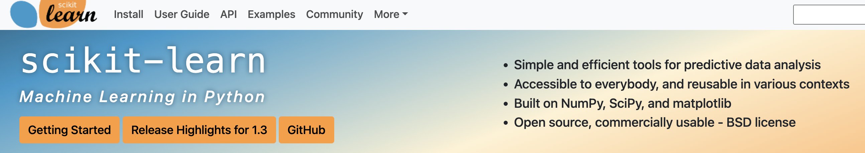
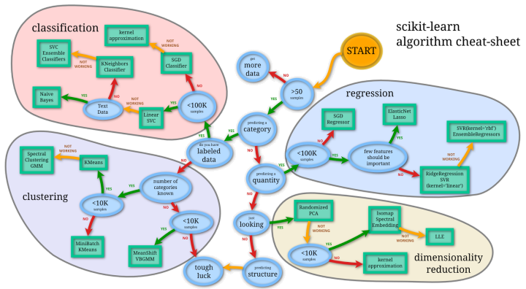
Learning
Scikit-learn
Link: https://scikit-learn.org/stable/

Slide 34
Learning
Conclusions
Learnt was is machine learning
Started to talk ML language
Learnt model pipeline
Figured out what tasks ML solves and what features could be

Slide 35
Afterword

Slide 36
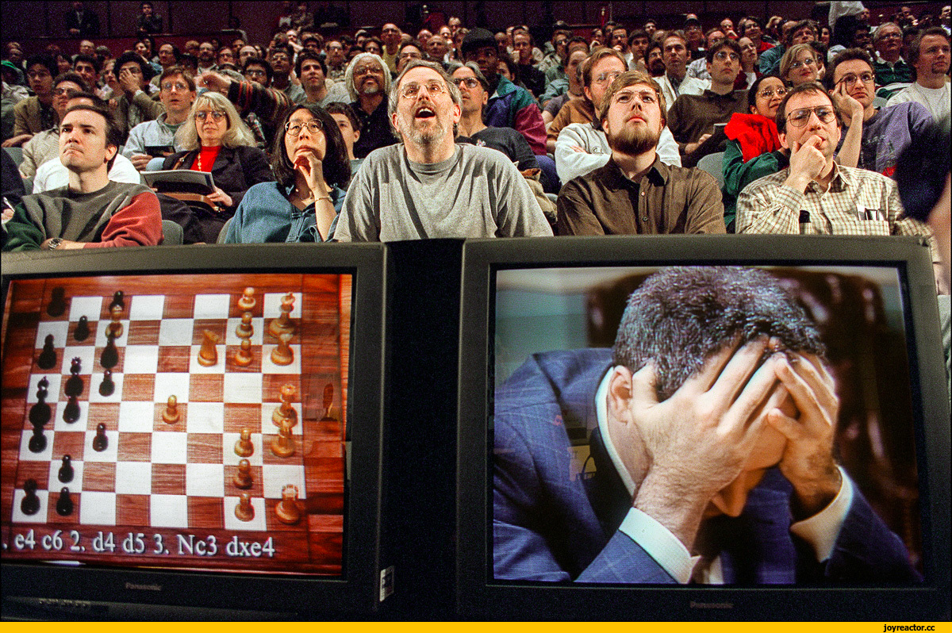
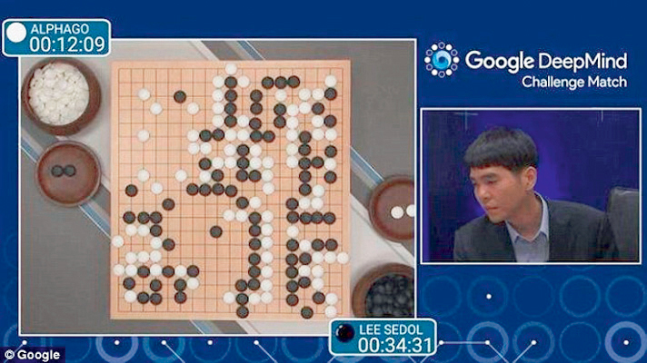
vs GO
Chess
Deep Blue vs Kasparov (1985)
~ 10^123 variants
AlphaGo vs Li Sedol (2016)
~ 10^360 variants
https://deepmind.com/research/case-studies/alphago-the-story-so-far

Slide 37
Why now?
Deep Blue vs Kasparov (1985)
~ 10^123 variants
AlphaGo vs Li Sedol (2016)
~ 10^360 variants
https://deepmind.com/research/case-studies/alphago-the-story-so-far

Slide 38

Examples
More
2017
https://www.wired.com/2017/01/mystery-ai-just-crushed-best-human-players-poker/

Slide 39
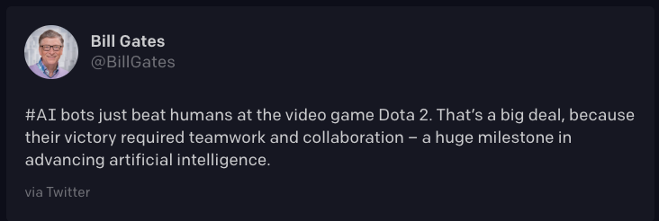
Examples
More
2017
2018
https://openai.com/projects/five/
https://www.wired.com/2017/01/mystery-ai-just-crushed-best-human-players-poker/

Slide 40

Examples
More
2017
2018
2019
https://openai.com/projects/five/
https://www.wired.com/2017/01/mystery-ai-just-crushed-best-human-players-poker/
https://deepmind.com/blog/article/alphastar-mastering-real-time-strategy-game-starcraft-ii

Slide 41
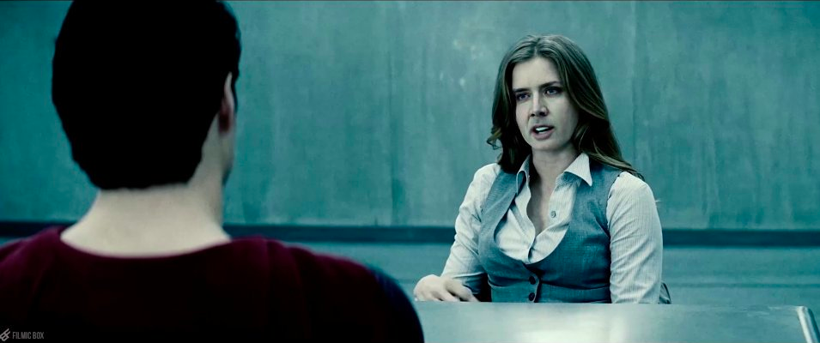
Deep Fakes
Not only games
https://www.youtube.com/watch?v=2jp4M1cIJ5A

Slide 42

Irish weather…
https://www.youtube.com/@unreal_keanu/shorts

Slide 43

Irish weather…
https://www.youtube.com/@unreal_keanu/shorts

Slide 44

Irish weather…
https://www.youtube.com/@unreal_keanu/shorts

